Slide 2
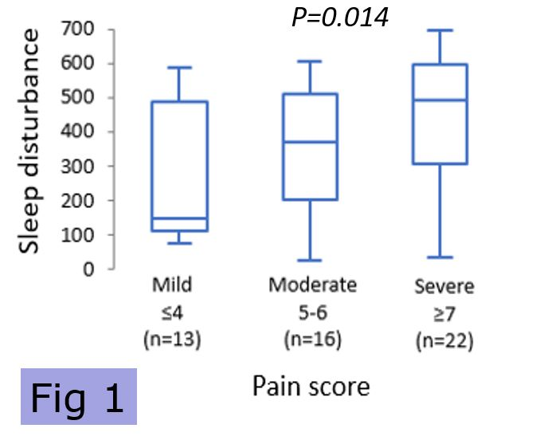
Chronic Pain and Sleep
Issues with sleep are common in patients with chronic pain, and sleep disturbance is worse in those with higher pain scores (Fig 1) .
Sleep disturbance increases the suffering, disability, and perception of pain.
The lack of sleep and poor sleep quality has been found to be a risk factor for the development of chronic pain
There is a bidirectional association between sleep and pain.
Adam R, Kanakarajan S, Onyeakazi U, Columb MO, Galley HF. BMJ Open 2020; 10: e034443.
DREAM-CP Study

Slide 3
MELATONIN
Melatonin is naturally occurring hormone and known for its effects on the sleep-wake cycle.
It also has anti-inflammatory properties.
In UK, CircadinTM is licensed at a dose of 2mg for the treatment of primary insomnia in people over 55 years.
In animal pain models, exogenous melatonin has been found to have beneficial effects on nociception, hyperalgesia and pain behaviour.

Slide 4
OBJECTIVE AND OUTCOMES
Melatonin should improve sleep disturbances in chronic pain patients.
Primary outcome - Decrease in sleep disturbance in participants at 6 weeks
Secondary outcomes –
Effect on sleep latency, sleep efficiency, sleep quality, sleep duration
Effect on pain intensity
Effect on Actigraphy daily pain and fatigue scores
Changes in melatonin levels (to rule out hang over effects)

Slide 5
STUDY DESIGN and timeline
Double blinded, randomised, cross over trial to evaluate the efficacy of Melatonin in diverse chronic pain populationover trial to evaluate the efficacy of Melatonin in diverse chronic pain population

Slide 6
SAMPLE SIZE
Powered for both sleep disturbance and Pain
Sleep disturbance – VSH score difference of 120 (80% power; effect size 0.6) – 46 patients
Pain score – difference of 2 on 11 point NRS at 80% power – 23 patients

Slide 7
INCLUSION AND EXCLUSION CRITERIA
INCLUSION CRITERIA
EXCLUSION CRITERIA
Malignant pain
Pain score below 7
Aged under 18
Liver function above normal range
Concomitant treatment with nifedipine or fluvoxamine, benzodiazepines or non-benzodiazepine hypnotics (zaleplon, zolpidem and zopiclone),
History of drug/alcohol abuse, post-traumatic stress disorder or use of psychotropic medications,
AWI
patients with known hypersensitivity to the drug product or/and any of its excipient.
Any subject who is pregnant, breastfeeding or planning to get pregnant
Non-malignant pain of more than 3 months duration
Average pain score of 7 or more on the BPI scale of 0 to 10,
Aged 18 or over
No expected change in medication during the trial
Normal liver function.

Slide 8
COVID – 19 modifications
Remote consenting and visits
Dropped participant facing activities - blood test, Psychomotor Vigilance Testing (after 18 patients)
Questionnaires and Actiwatches were dropped off/ picked up from participant’s homes

Slide 9
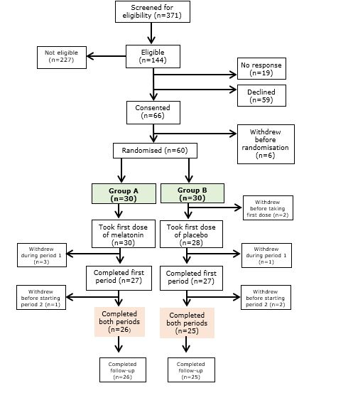
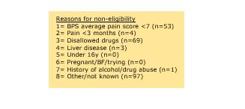
CONSORT
For RCT- Cross over trial

Slide 10
Baseline characteristics
 | Group A Melatonin first (n=30) | Group B Placebo first (n=28)
Pain Type: Nociceptive/mainly nociceptive Neuropathic/ mainly neuropathic Mixed | 15 7 8 | 11 11 6
Pain Location Neck Thorax, upper back or abdomen Upper or lower limbs Low back pain Widespread pain | 3 2 7 7 11 | 1 3 10 9 5

Slide 11
Baseline characteristics
 | Group A Melatonin first (n=30) | Group B Placebo first (n=28)
Age, y (%) | 62 [24 -79] | 55 [28 -79]
Sex, n (%) Male Female | 10 (33%) 20 (67%) | 12 (43%) 16 (58%)
Pain duration, months | 96 [12 - 336] | 96 [24 - 480]
Ethnicity, n (%) White Other White Asian Black | 28 (93%) 1 (3%) 1 (3%) 0 | 27 (96%) 0 0 1 (3.6%)
Smoking status, n (%) Never smoked Ex-smoker Smoker | 10 (33%) 13 (43%) 7 (23%) | 15 (55%) 9 (32%) 4 (14%)
Body mass index, kg/m² | 29.8 [22.7 - 51.3) | 30.3 [20.4 – 48.0]
Data are shown as number or median [range] as appropriate, with % in parentheses.

Slide 12
BASELINE OUTCOME MEASURE
 | Group A Melatonin first | Group B Placebo first | Sampling probability
Verran, Snyder-Halpern sleep scale Sleep disturbance Sleep latency Wake after sleep onset | 481 [67-632] 89 [4-100] 54 [3-100] | 409 [122-673] 50 [0-100] 43 [0-90] | P=0.06 P=0.18 P=0.24
Data shown as median [range]

Slide 13
 | Group A Melatonin first | Group B Placebo first | Sampling probability
Brief Pain Inventory Pain intensity score Sleep interference score Psychological interference score Pittsburgh Sleep Quality Index Global Score Sleep duration (hours) Pain and Sleep Quality 3-Item score | 7 [7-10] 8 [1-10] 17 [0-30] 12.5 [4.0-17.0] 5.0 [2.0-7.5] 248 [57-300] | 7 [7-10] 8 [5-10] 17 [3-28] 12.0 [5.0-16.0] 2.0 [2.0-8.0] 214 [83-299] | P=0.38 P=0.86 P=0.75 P=0.31 P=0.56 P=0.08
BASELINE OUTCOME MEASURE
Data shown as median [range]

Slide 14
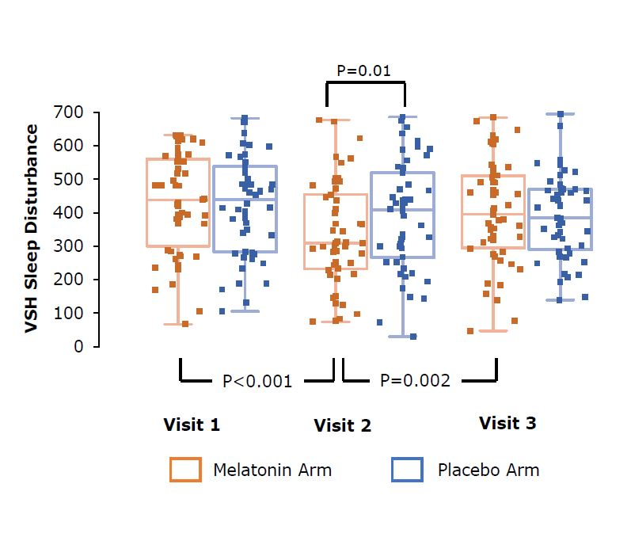
RESULT -SLEEP DISTURBANCE - VSH
Sleep disturbance score was not different between melatonin and placebo at 6wk but fell transiently during melatonin treatment

Slide 15
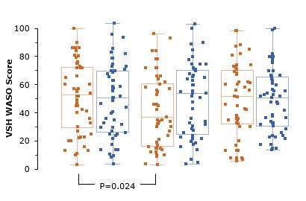
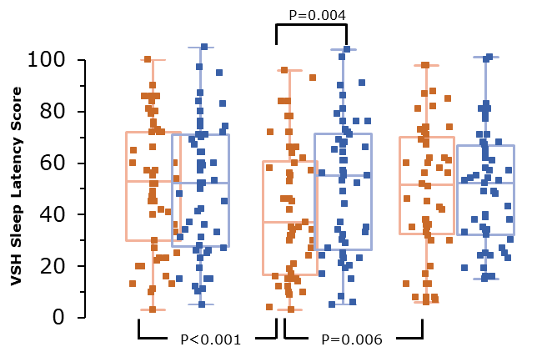
RESULT- SLEEP LATENCY AND WASO
Sleep latency
WASO
Transient effects on other sleep parameters including sleep latency and wake after sleep onset (WASO) were also seen during the melatonin treatment period.

Slide 16
P=0.032
A
RESULT-PSQ-3 AND PSQI SCORES
PSQ-3 Total Score
P<0.001
P<0.001
B
P=0.004
PSQI Global Score
P<0.001
P<0.001
Baseline
3 weeks
6 weeks
Melatonin period
Placebo period
PS3-3 and PSQI sleep quality scores decreased significantly after 3- and 6-weeks’ melatonin treatment with a significant difference between melatonin and placebo treatment periods at 3 weeks

Slide 17
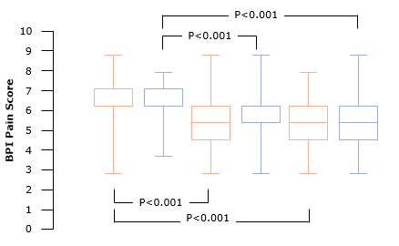
RESULT- PAIN INTENSITY
The average pain intensity scores captured by the BPI decreased during both treatment periods

Slide 18
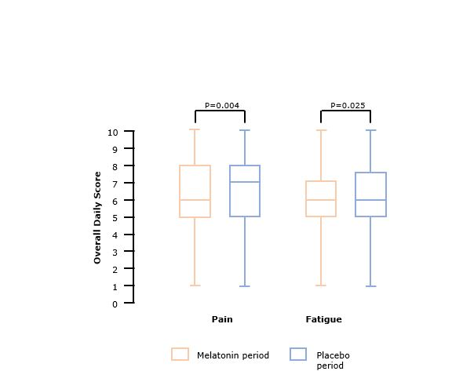
ACTIWATCH PAIN AND FATIGUE SCORE
Actiwatch pain and fatigue data showed very small, but significant, overall reduction during melatonin treatment compared to placebo treatment

Slide 19
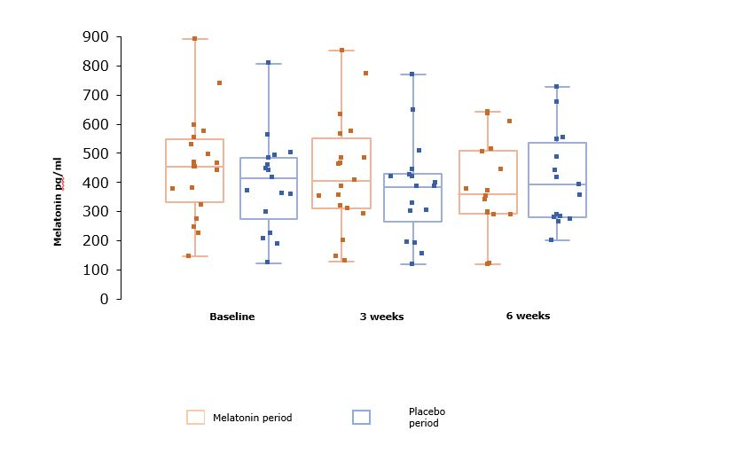
Blood sampling
There was no difference in circulating melatonin levels during the melatonin or placebo treatment and no change during treatments

Slide 20
ADVERSE EVENTS
 | Number of adverse events
Event | Melatonin period | Placebo period | Total during treatment
Headache | 4 | 8 | 12
Drowsiness | 1 | 1 | 2
Nightmares | 3 | 1 | 4
Infections | 11 | 11 | 22
Mental health issues | 2 | 1 | 3
Gut problems | 10 | 9 | 19
Skin problems | 5 | 1 | 6
Joint problems | 2 | 2 | 4
Other | 11 | 13 | 24
Total | 49 | 47 | 96
Adverse events were similar during Melatonin and placebo periods

Slide 21
CONCLUSION
Treatment with 2mg melatonin did not improve sleep disturbance at 6 weeks
Transient beneficial effects at 3 weeks were noted in all sleep parameters.
During trial participation, patients with chronic pain reported lower pain intensity scores.

Slide 22
ACKNOWLEDGEMENT
We are grateful to the BJA/RCoA for funding and Flynn Pharma for providing trial drugs

Slide 23
QUESTIONS?

